Slide 1
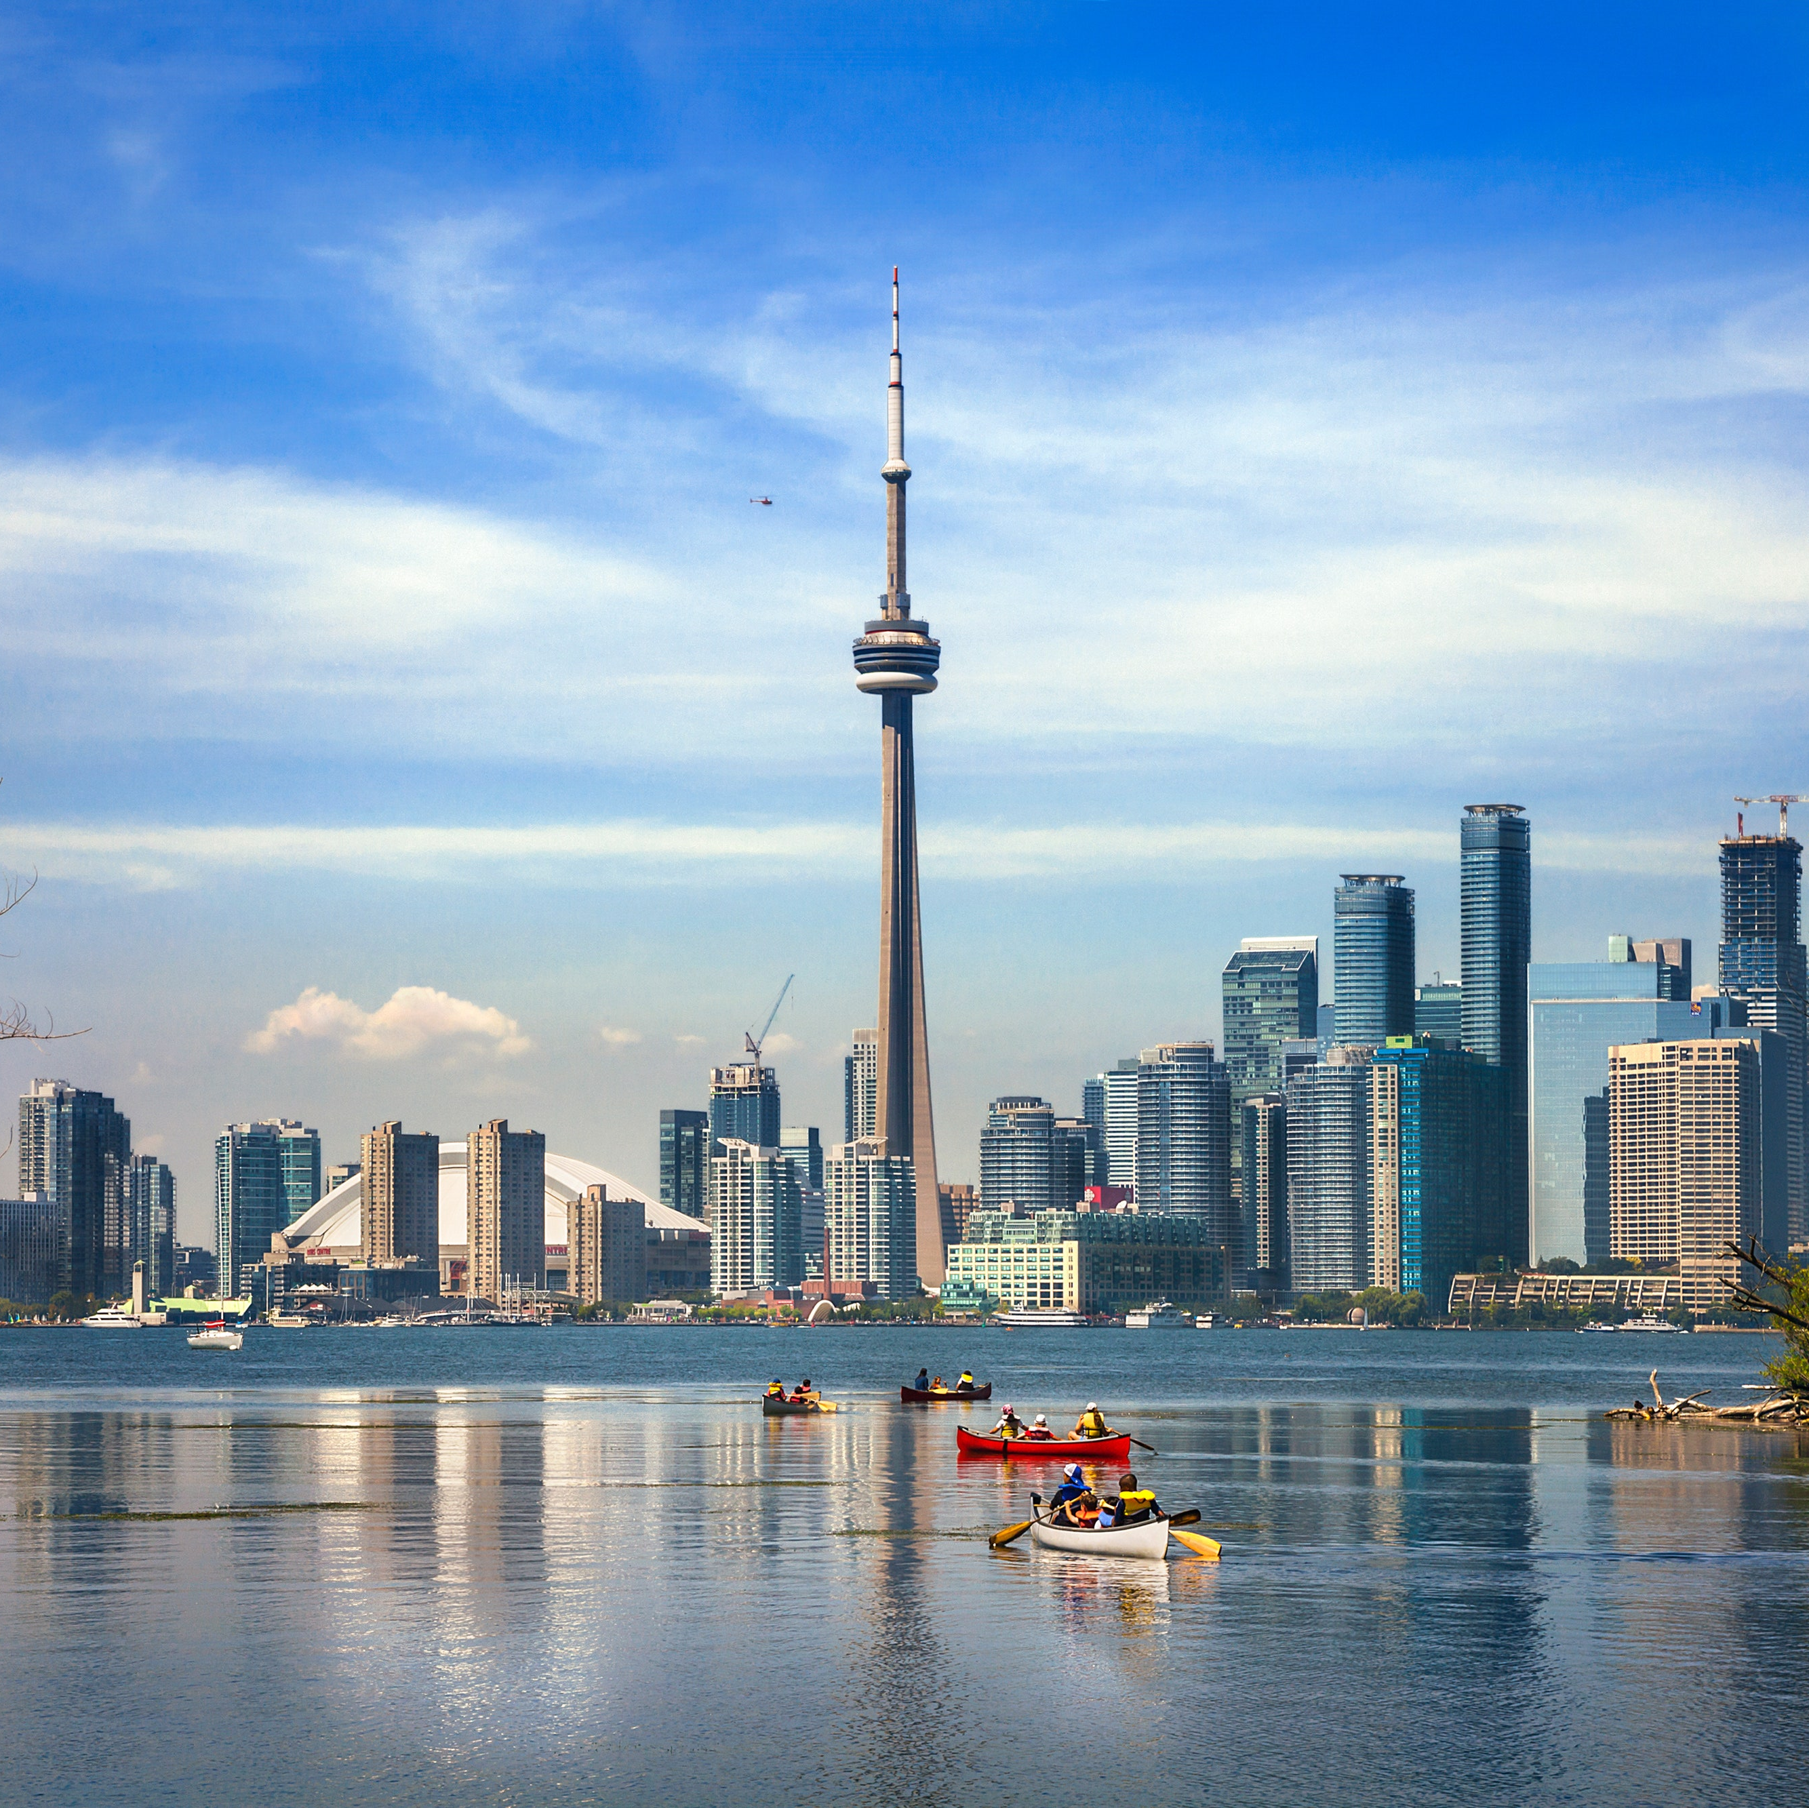
BATTLE OF NEIGHBORHOOD IN TORONTO
DIVYANSHI GARG
Subtitle comes here

Slide 2
INTRODUCTION
The purpose of this Project is to help people in exploring better facilities around their neighborhood. It will help people making smart decision on selecting appropriate neighborhood.
It will help people to get awareness of the area and neighborhood before moving to a new city, state, country or place for their work or to start a new fresh life. Developers, investors, policy makers and/or city planners have an interest in the need for additional services and citizen protection.
Lots of people are migrating to various states of Canada and needed lots of research. This project is for those people who are looking for better neighborhoods. For ease of accessing to Cafe, Restaurant, Shopping Stores, Hotels etc.
This Project aim to create an analysis of features for a people migrating to Tornoto to search a best neighborhood as a comparative analysis between neighborhoods. It will help people to get awareness of the area and neighborhood before moving to a new city, state, country or place for their work or to start a new fresh life.

Slide 3
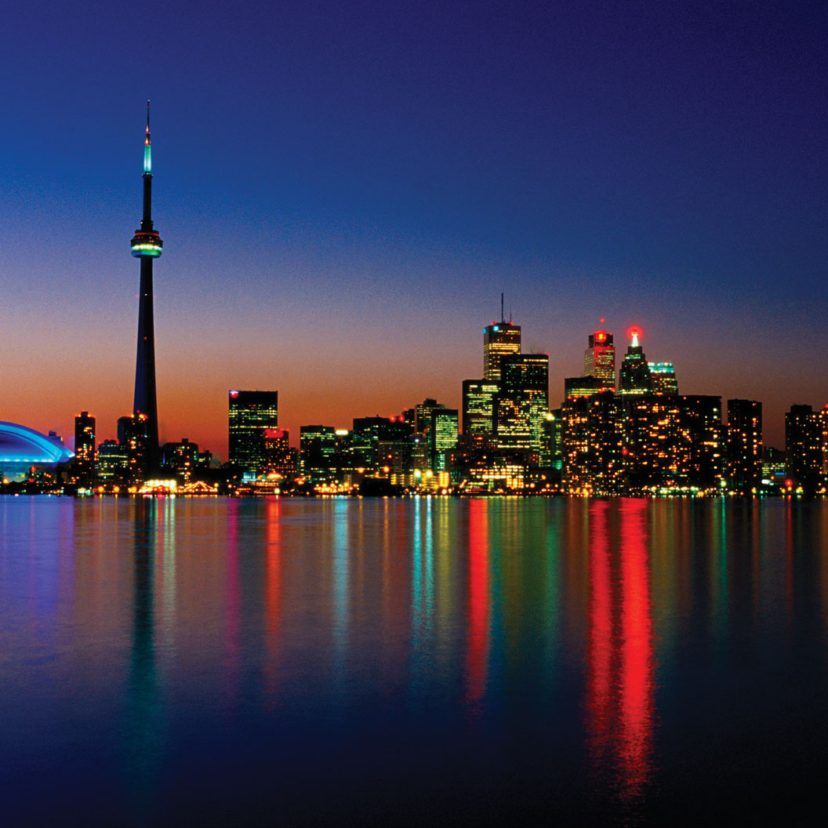
PROBLEM
• Which neighborhoods are suitable as per hotels, restaurants, café and shopping stores?
• List and visualize all major parts of Toronto that is great neighborhoods for any event.
• Using foursquare data, what venues are most common in different locations within the city?

Slide 4
Data
This data will allow analyze and examine to justified problem. The data will enable us to group venues by neighborhood.
The data used is provided by Foursquare API. The data are grouped by landscape area and all information about cafe, shopping stores, hotels and restaurants is gathered relevant to conduct any event.
Toronto locations of interest will cluster the venues most common to that location.
Foursquare Developers Access to venue data: https://foursquare.com/

Slide 5
methodology
Import Libraries
Define Foursquare credentials
Define the city and its coordinates
Search for Hotels, Restaurants, Cafeteria & Shopping stores and clean data frame.
Generate map to visualize clustering of hotels, shopping stores, cafeteria & restaurants.

Slide 6
results
Sheraton Centre Toronto Hotel, Rich tree Natural Market Restaurants, Imago Restaurants, Upstairs Café, Saks Fifth Avenue Club - Personal Shopping etc are found to be the neighborhoods relevant for an event.

Slide 7
Thank you

